Slide 1
IPLC
Capability Deck

Slide 2
Global Footprint
31.4%
Wireless Subscriber Market Share
Source: TRAI Report
470+
2.5
Million People
Billion People
Subscriber Base Worldwide
470+ Million subscriber base w/100 Million+ Internet customers and growing every day
Data & Voice
250 Bn (Voice Minutes Carried), 100+ Countries DID and ITFS Services & 700+ Carrier Partnerships
#1 OPERATOR IN INDIA
Present in 16 Countries
7 Cable Landing Stations
200+ India and Global POPs
Full Service Portfolio
B2C & B2B
75,000
VSAT Terminals
50 Country Global Network Across 5 Continents
CUSTOMERS
2000+
45%
1Mn+
Enterprise & Govt.
1,200+ Global Carrier Partnership
Small and Medium Enterprises

Slide 3
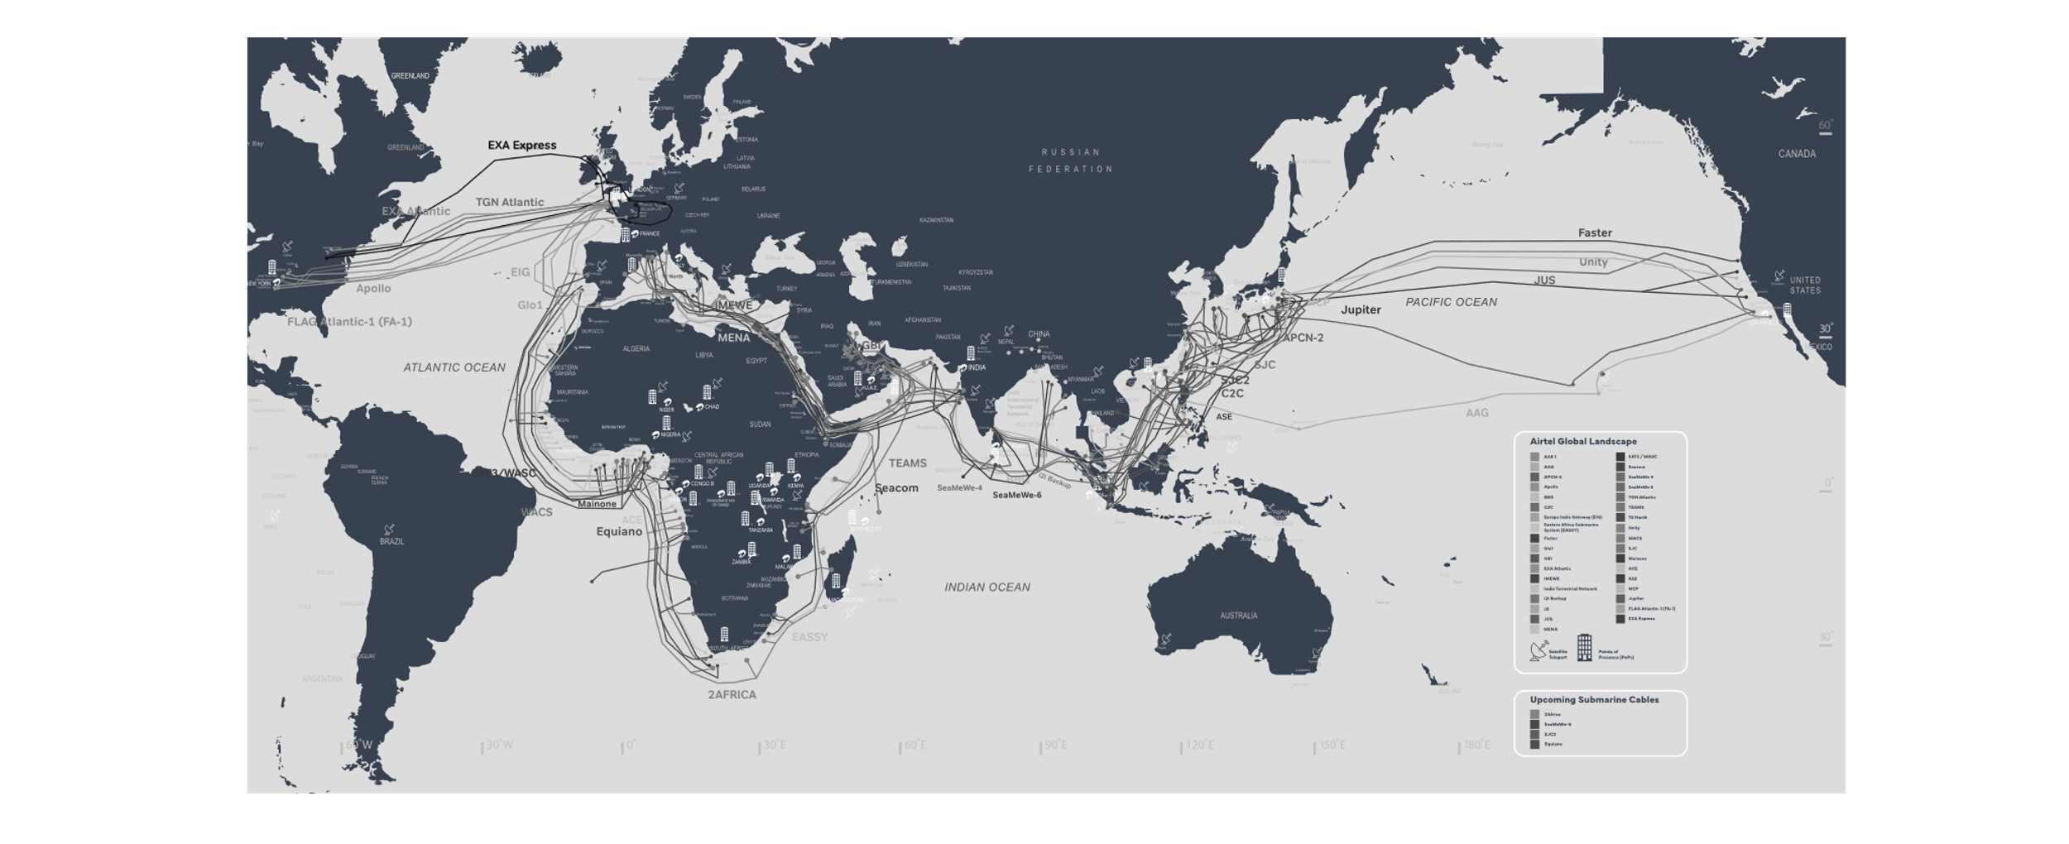
Airtel Cable System Offerings
4,00,000+ Route KMS Across
50 Countries & 5 Continents
65+ Global PoPs
16 Countries Presence
30+ Satellites
#GoForGrowthWithAirtel

Slide 4
Airtel cable system
34+
7 CLS
3 Min
International
Cables capacities
paths on every route
IND-ME-EU
SAARC (T)
Africa East
Africa West
Atlantic
IND-SNG
SNG-HK/JP/US
JP-US
SMW4
Nepal
Seacom
Mainone
TAT 14
i2i
ASE
Unity
IMEWE
Bangladesh
Eassy
Glo1
Hibernia
SMW4
C2C
NCP
EIG
Bhutan
Teams
WACS
Apollo
i2i Backup
SJC
FASTER
MENA
Mayanmar
2Africa
ACE
TGN
BBG
APCN2
JUS
BBG
SAT3
AAG
GBI
Equiano
Notes:
EIG (Mum to Oman) + OAC (Oman to Australia) + NLD (Mumbai to Chennai)+i2i (Chennai to Singapore)+ Indigo-west (Sing to Aust)

Slide 5
Emerging Markets Depth - India & SAARC
Meshed Terrestrial connectivity from India to Nepal, Bhutan, Myanmar & Bangladesh
BHUTAN
2 entry points to Bhutan from Phuenshotling and Gelephu
SRI LANKA
SMW4 backed by SMW3 & BBG
NEPAL
3 entry points to Nepal from Sanauli, Sagauli, Forbesganj
MYANMAR
Terrestrial link providing seamless connectivity
BANGLADESH
One entry point via Petropole terrestrially and second entry point via Cox Bazaar on SMW4
INDIA
Internet Gateway Ownership at Mumbai & Chennai

Slide 6
Emerging Markets Depth - Africa
14 Country presence
$11 Bn
Investment
Wireline & VSAT Connectivity to land-locked countries
3 path Connectivity from West & East Africa
99
MPLS PoPs
90+ Mn
Mobile subscribers
WEST AFRICA TO EUROPE
Connectivity through WACS, SAT3, Main One & GLO1 cables
EAST AFRICA TO LONDON & INDIA Connectivity through submarine cables EASSY/EIG,TEAMS/SMW4/IMEWE & SEACOM

Slide 7
Emerging Markets Depth - Middle East
PoPs
SmartHub Fujairah, Datamena Dubai
Multiple Cables Options
GBI, SMW4, EIG, IMEWE, TE North and TEAMS
Direct Coverage
UAE, Saudi Arabia, Oman and Egypt
Coverage Through Partnerships
Qatar, Bahrain, Kuwait, Iran, Iraq
MPLS NNI
With ME carriers for complete coverage

Slide 8
South East Asia & America
India to Singapore owned connectivity on i2i,SMW4,BBG, AAE1
Transmission PoPs at Singapore, Hong Kong, LA, NY
Intra-Asia & Trans pacific connectivity using SJC, ASE, SJC2, AAG, FASTER, NCP, Jupiter & UNITY cables
Self-owned intra city fiber network in Singapore connecting SMW4 – i2i –AAG landing stations
AAG cable covering SE Asia & US west coast avoiding seismic zone of Japan
Satellite coverage of remote pacific islands such as PNG
SJC2 – Upcoming Investment, RFS 2024

Slide 9
Airtel Upcoming Cables
2AFRICA CABLE
EQUIANO CABLE
SMW6 CABLE

Slide 10
2Africa - Overview
2 Africa is poised with following structure:
West from UK to South Africa
East from South Africa to Egypt
North from Egypt to Italy
Med from Italy to Spain
2Africa Pearls – Egypt to India
Total 34 Landing stations
RFS Q4 – 2023
Design: Min. 12 T per FP

Slide 11
2Africa – Airtel Landings
2Africa West Landings
South Africa – Yzerfontain
Angola – Luanda
Congo Brazzaville – Loango
DRC – Muanda
Nigeria – Port Harcourt
Nigeria – Lagos
Ghana – Accra
UK - WideMouth
2Africa East Landings
South Africa – Duyenfountain
Madagascar – Mahajanga
Tanzania – Dar-e-salaam
Kenya – Mombasa -1
Kenya – Mombasa - 2
Djibouti – Haramous
Egypt - Rasgariib
UK - WideMouth
2Africa Med
2Africa North
2Africa West
2Africa East
2Africa North & MED Landings
NORTH
Egypt – Port Said
Italy - Genova
MED
Italy - Genova
France - Marseille

Slide 12
EQUIANO - Overview
12-fiber pair system connecting South Africa and Portugal
Airtel has access to the following landing points:
Melkbosstrand, South Africa (Trunk)
Lagos, Nigeria ( Branch)
Sesimbra , Portugal (Trunk)
Airtel has access to the following optional branches :
Accra, Ghana (branch)
Swakopmund, Namibia (branch)
RFS Q1 2023
Design: Min. 12 T per FP
Madeira
St Helena
Sesimbra
Melkbosstrand
Morocco
Tenerife
Senegal
Cape Verde
Conakry
Ivory Coast
Ghana
Lagos
DRC/ Congo
Namibia
Branch BU
Stub BU
Tongo

Slide 13
Airtel Upcoming Cables
2 Africa is poised with following structure:
West from UK to South Africa
East from South Africa to Egypt
North from Egypt to Italy
Med from Italy to Spain
Total 33 Landing stations / RFS Q4 – 2023
2AFRICA CABLE
Blue Raman– Overview
Blue Raman
12-fiber pair system connecting South Africa and Portugal. .
Airtel has access to the following landing points and optional Branches
Melkbosstrand, South Africa (Trunk)
Lagos, Nigeria ( Branch)
Sesimbra , Portugal (Trunk)
Accra, Ghana (branch)
Swakopmund, Namibia (branch)
RFS : Q1 2023
Cable connecting (Europe – India)
Ready for Service: Q4 – 2024
EQUIANO CABLE
Cable connecting (Europe – India – Singapore)
Ready for Service : Q4 – 2024
Fiber Pairs : 8 (SMW6 core system)
Additional Exclusive 4 FPs for Airtel (Mum – SNG with Chennai Branch option)
SMW6 CABLE

Slide 14
SMW6 – Overview
SMW6
Cable connecting (Europe – India – Singapore)
Ready for Service: Q4 – 2024
Fiber Pairs: 10 (SMW6 core system)
Additional Exclusive 4 FPs for Airtel (Mum – Chennai- SNG)
Design Capacity:
16 to 18 Tbps per FP
Project Status
CIF 31-Jan’22
Supplier - SUBCOM

Slide 15
Airtel Opcos In Africa
Tunisia
Morocco
Algeria
Libyan Arab
Jamahiriya
OPCOs
Airtel CHAD
Airtel DRC
Airtel Gabon
Airtel Kenya
Airtel Madagascar
Airtel Malawi
Airtel Niger
OPCOs
Airtel Nigeria
Airtel Congo B
Airtel Rwanda
Airtel Seychelles
Airtel Tanzania
Airtel Uganda
Airtel Zambia
Egypt
Cape Verde
Mauritania
Mali
Niger
Eritrea
Senegal
Burkina
Faso
Chad
Sudan
Djibouti
Gambia
Guinea
Benin
Guinea Bissau
Ivory Coast
Ghana
Nigeria
Central African
Republic
Ethiopia
Sierra Leone
Togo
Cameroon
Rwanda
Gabon
Democratic
Republic of Congo
Uganda
Kenya
Tanzania
Malawi
Seychelles
Burundi
Comoros
Angola
Zambia
Mauritius
Madagascar
Namibia
Zimbabwe
Botswana
Mozambique
La reunion
South Africa

Slide 16
Airtel Africa- Backbone/Intercity Fiber Footprint

Slide 17
SUCCESS STORIES | OUR CUSTOMERS
MNO
Media & Broadcasters
Next Gen (Content, ISVs, etc)
Carrier & Wholesalers
Satellite
Notes:
Okay for now

Slide 18
Thank You

